Slide 1

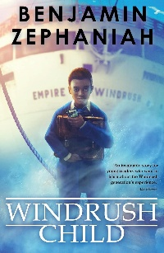

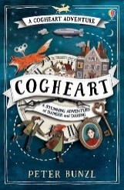

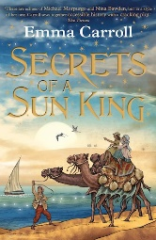






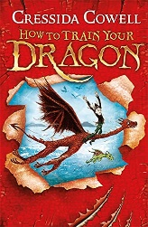




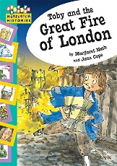
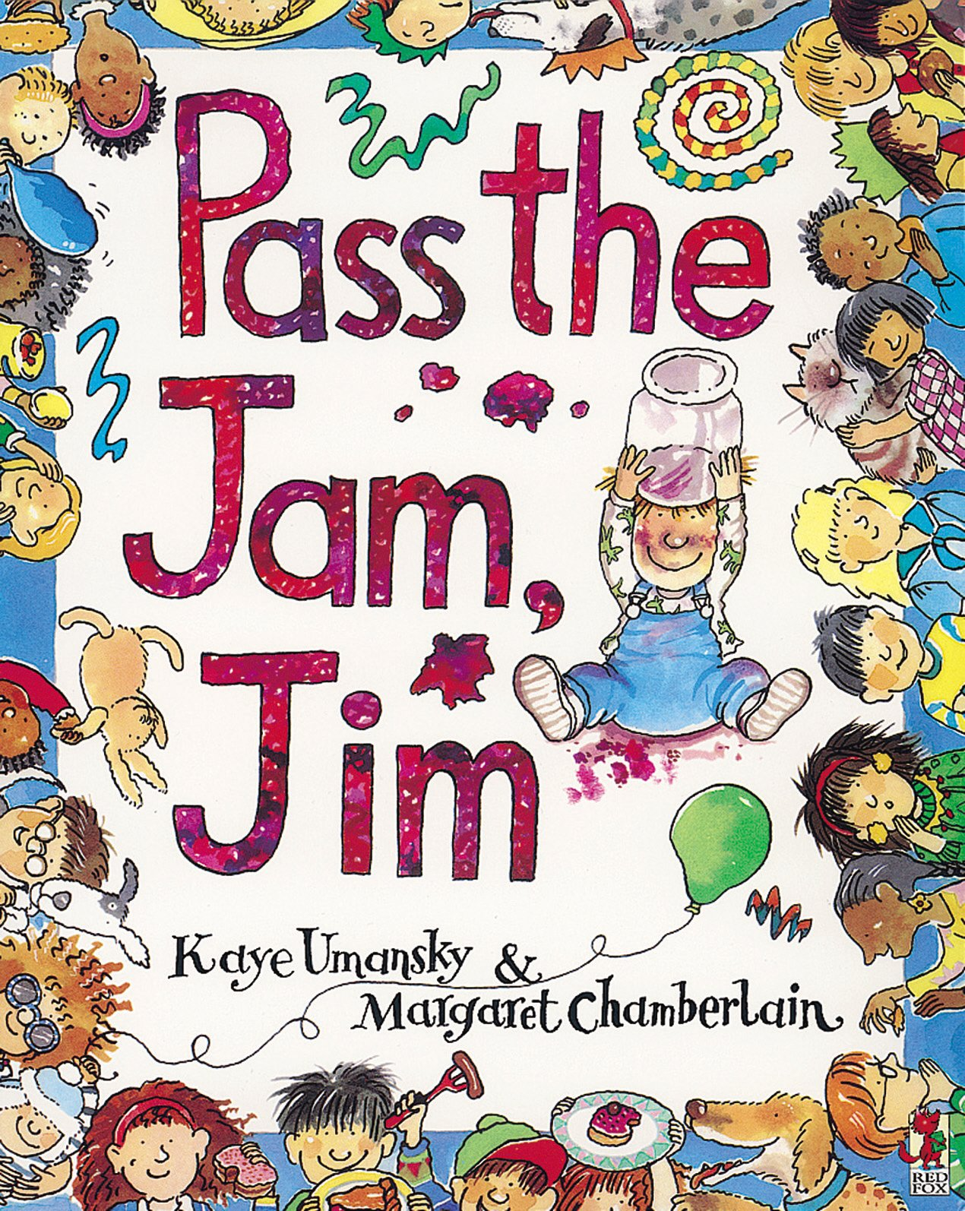


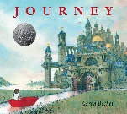





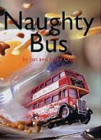





READING: WHOLE SCHOOL JOURNEY
“The more that you read, the more things you will know. The more that you learn, the more places you'll go…”
- Dr. Seuss
Windrush Child:
Benjamin Zephaniah
Goodnight Mister Tom:
Michelle Magorian
Cogheart:
Peter Bunzel
Year
6
Year
5
Maz Evans:
Who let the Gods Out
Emma Carroll:
Secrets of a Sun King
Treason:
Berty Doherty
Katherine Rundell:
The Explorer
Charlie & the Chocolate Factory:
Roald Dahl
Empire’s End – A Roman Story:
Leila Rasheed
Year
4
Stig of the Dump:
Clive King
Charlie Changes into a Chicken:
Sam Copeland
How to Train your Dragon:
Cressida Cowell
Year
3
Traction Man:
Mini Grey
Meerkat Mail:
Emily Gravett
The Sheep Pig:
Dick King-Smith
A Bear Called Paddington: Michael Bond
Toby & the Great Fire of London:
Margaret Nash & Jane Cope
Year
2
Gunpowder Plot:
Gillian Clements
What the Ladybird Heard:
Julia Donaldson
Pass the Jam Jim:
Kaye Umansky
Journey:
Aaron Bcker
Neil Armstrong:
Maria Isabel Sanchez
The Way Back Home:
Oliver Jeffers
The Lighthouse Keeper’s Lunch:
Ronda & David Armitage
The Tiny Seed:
Eric Carle
Out and About:
Shirley Hughes
Year
1
Year
R
See the St. Luke’s Reading Spine documentation

